Slide 1

Monthly Claim System
Programming 6212
By Amile Dlamini
ST10456326

Slide 2

Project Overview
The monthly claim system is a system where lecturers in the organization submit claims to get approved. (DeepSeek, 2025).
In this system, there are 4 entities, which are the lecturer, the programmer coordinator, the academic manager, and human resources. (IIE, 2025)
The submission of the claim process is a bit complex, which contains auto calculations, a predetermined hourly rate, supporting documents, and description text for what is being submitted. (IIE, 2025)
Once the claim is submitted, it goes through different approvals, which are the programmer coordinator and academic manager. (IIE, 2025)
There is also a Human Resource employee who can add/update/mangers users. They can generate reports and set the hourly rates. (IIE, 2025)

Slide 3

Extra Features and techniques
Deactivation feature: HR can deactivate a user account from the system and make them inactive. (Information from my project)
Download report: HR can download a report by filtering the data. The download data saves as an Excel file. (Information from my project)

Slide 4

Security and Role Implementation

Slide 5
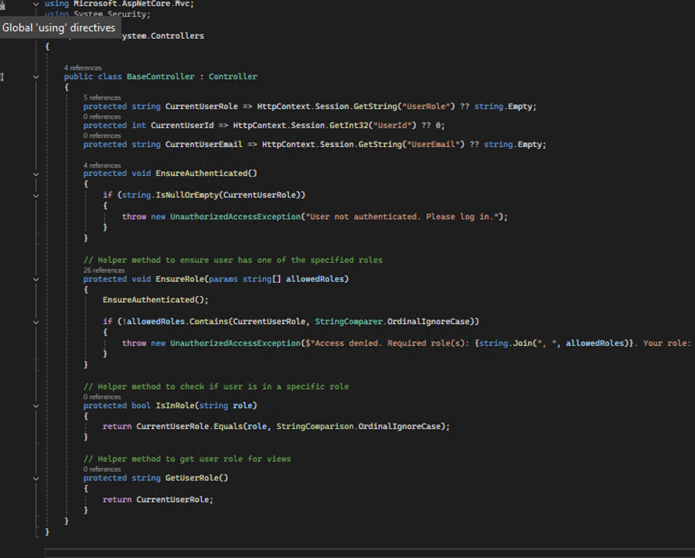
Security Architecture
The application contains a base controller the basically manages the whole security system. The base controller helps keep the whole application secure. For example, a role can’t enter another roles dashboard. (DeepSeek, 2025).

Slide 6

Role Implementation
Sessions management is the feature that makes the role implementation possible. Web applications can store user-specific data on the server side while keeping a distinct session identifier on the client thanks to sessions in web development. (Sathya, A. 2022).
Now let talk a little about the roles
Lecturer = Lecturer constructs the claims. Once they have logged in, they click new, claim fill in the fields (like description, hours worked, etc.) on the form. The only field they don’t interact with is the hourly rate because it's set by HR. When they are done, they submit the claim, and it becomes a pending claim. (IIE, 2025)
Coordinator = Coordinator is the first phase of the approval. Once they are logged in, they must sort out the pending claim that was just submitted by the lecturer. The coordinator's main job is to approve or reject the claim. They can also view the details of the claim. Once they submit the claim goes to the next level. (IIE, 2025)
Academic Manager = Academic manager is the last phase of the approval claim. The manager has a similar job, and that is rejecting and approving the claims. They can see the approval history from the coordinator. (IIE, 2025)
HR = Human resource has full control over the system. The HR have full management over the users and can edit or add or view them. The HR can also set the hourly rate and generate a report with filters. (IIE, 2025)

Slide 7
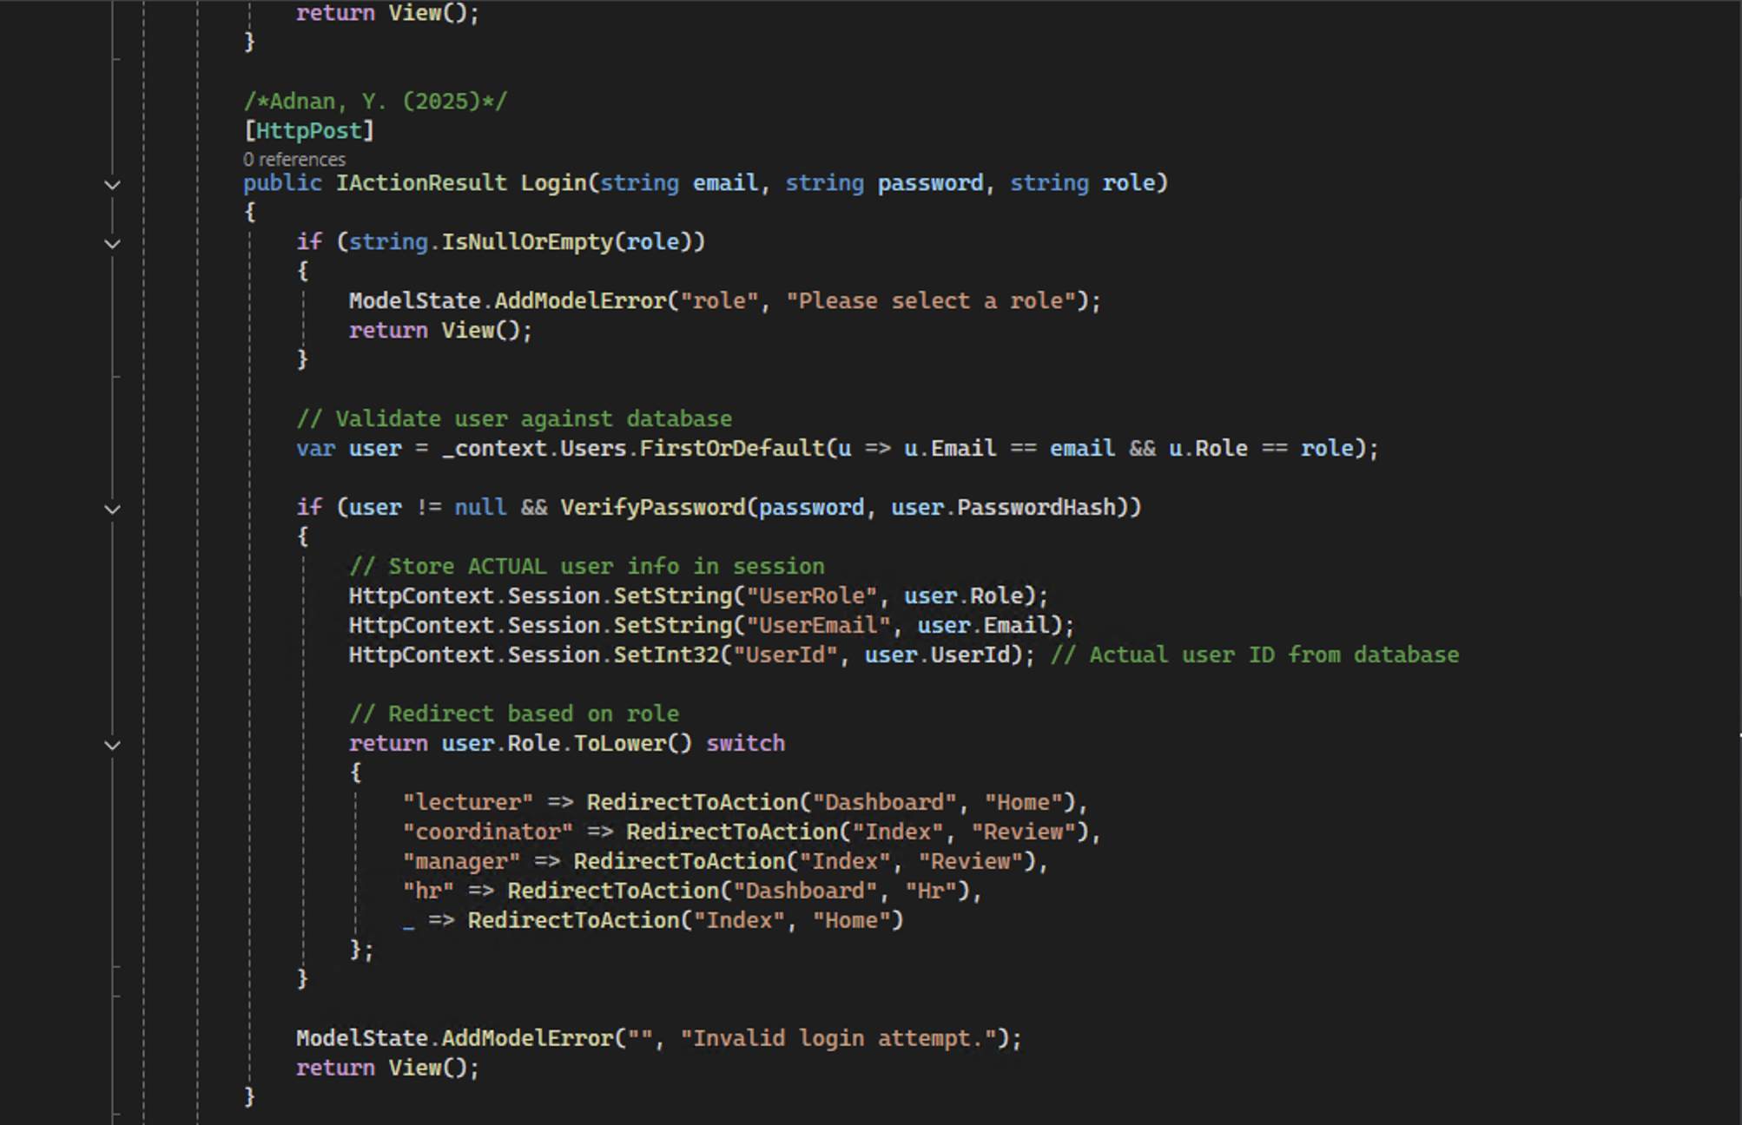
Brief code overview
Account Controller
This method is important because it essentially handles the user entry the project. The user needs to login their credentials so that the application know which session to pull up. (DeepSeek, 2025).

Slide 8
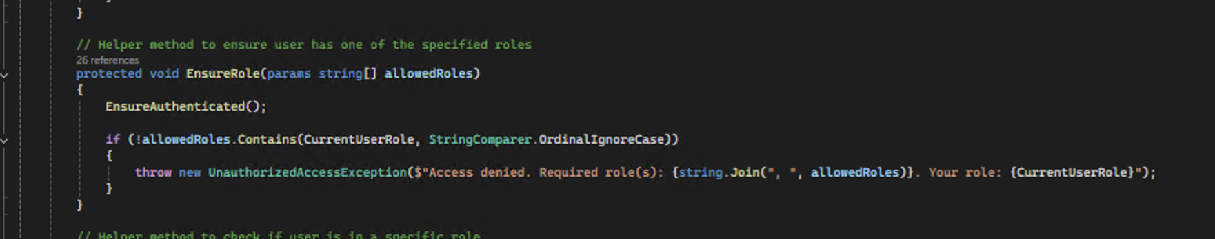
Base Controller
This method is very important because it keeps the application secure. This method makes sure that all the users are in their respected pages and authentication is present. (DeepSeek, 2025).

Slide 9
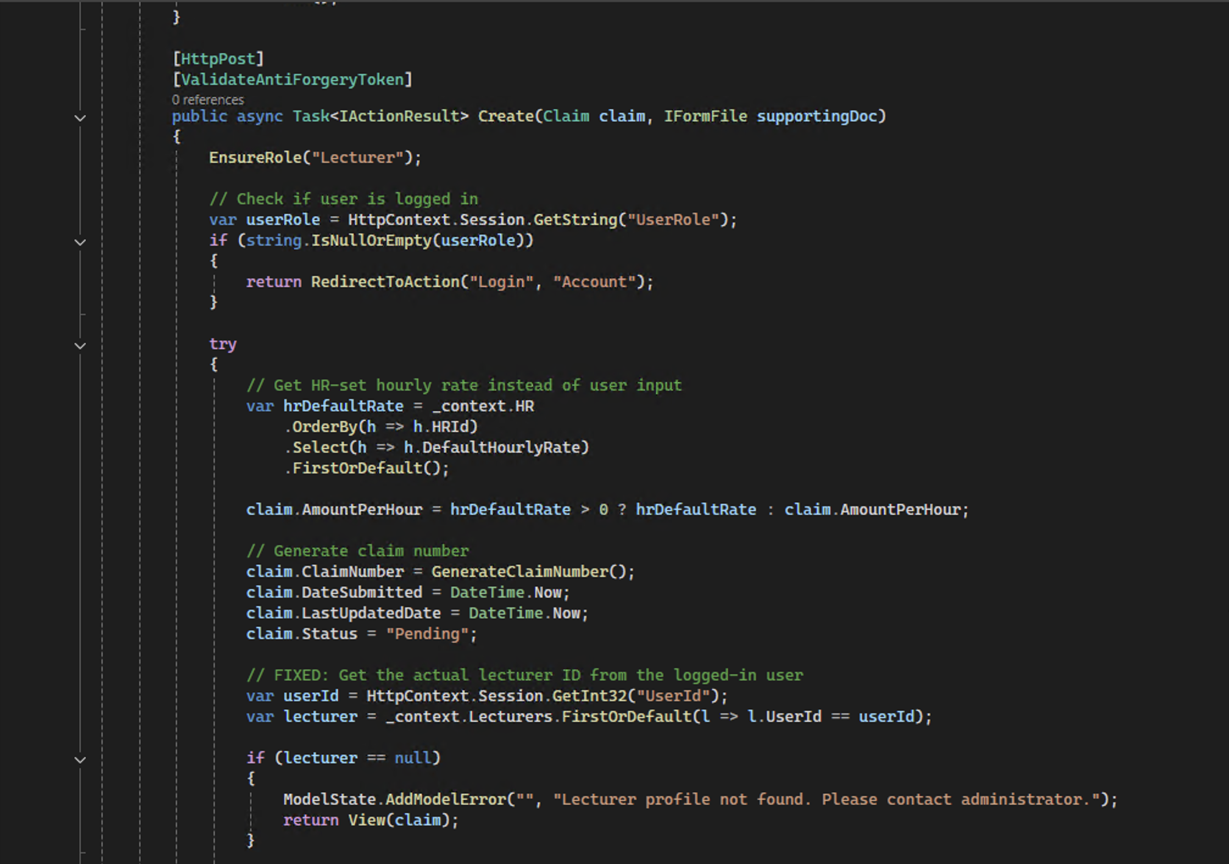
Claim Controller
This methods helps the lecturer create their claims. The method also contains rules of the automated HR hourly rate. (DeepSeek, 2025).

Slide 10
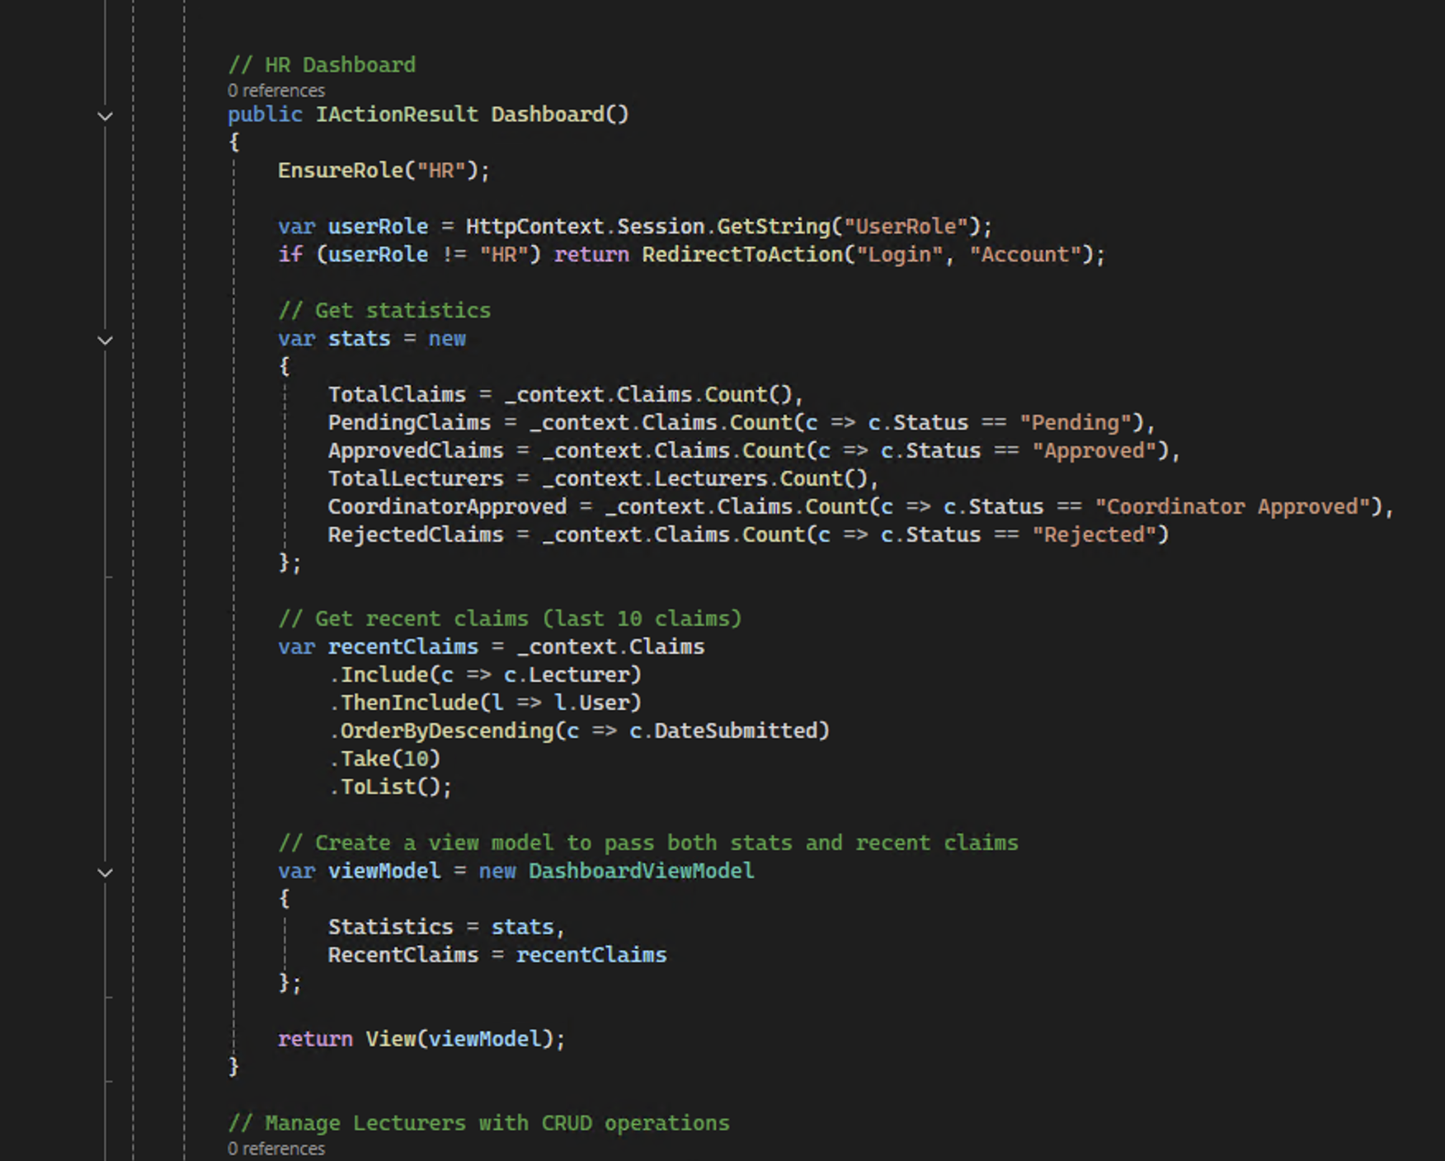
HomeController
This method is key because it helps display the content of every user's pages. (DeepSeek, 2025).

Slide 11
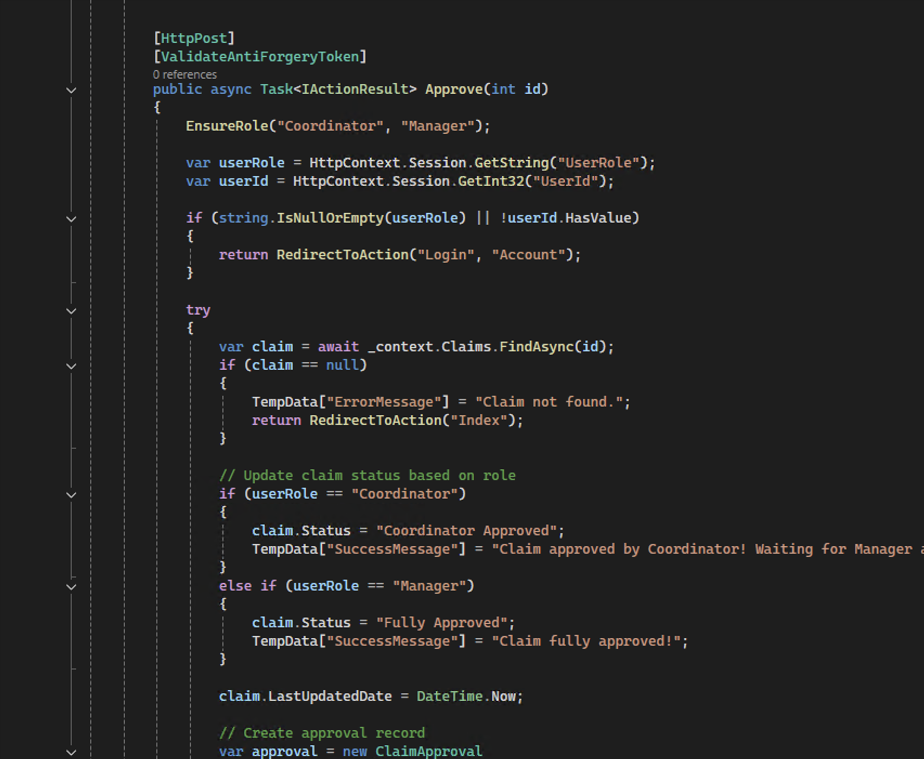
Review Controller
This method is important because it helps get the approval process going. If this method is not present, then the claim would not be able to be passed down the academic manager which will mean that the claim can't be full approved. (DeepSeek, 2025).

Slide 12
Referencing
Dot Net Tutorials, (N/A). Sessions in ASP.NET Core MVC. Available at: < https://dotnettutorials.net/lesson/sessions-in-asp-net-core-mvc/ > (Accessed: 18 November 2025).
DeepSeek, (2025). DeepSeek [AI model]. Available at: < https://chat.deepseek.com/a/chat/s/9ec6d300-3f2e-4ab8-8ce9-3042fc2fad90 > (Accessed: 21 November 2025).
The Independent Institute of Education, 2025. Programming [PROG6212]. Nt. [online via internal VLE] The Independent Institute of Education, Available at: < 2BPROG6212POE.docx >[Accessed Date: 1 March 2025].

